Slide 1
Party Line Predictor (Water Systems)
Water System
Water Main: These are the larger diameter pipes that carry water from the source across the territory that the public water authority serves
Water Service Line: Usually perpendicular pipes branching off of the mains that carry water to individual homes or businesses
Party Line: A water service line that branches off of a water main but serves more than one home or business

Slide 2
Party Line Predictor (Water Systems)
PROBLEM (general):
Party lines can cause accountability issues. If entity A pays their water bill and entity B does not, there is no way to shut off water to the line that serves B without cutting A off of water as well.
Is there a way to use the spatial relationship of the water mains and service lines in addition to their relationship to the entities (houses, businesses etc.) to logically surmise whether a given line or group of lines is a party line?

Slide 3
PROBLEM (technical): The data provided, while useful, had technical challenges that had to be worked around.
The service lines themselves in the GIS data were not “continuous”. This meant that a service line could be composed of multiple, broken up “pieces of” line but still only serve one entity and in reality is only one line.
Therefore, identifying a party line is not as simple as counting the number of broken up lines that compose a service. Rather, the number of entities that the service serves identifies a positive or negative party line.
Because many of the services often consist of broken up lines in the GIS, counting the number of entities that intersect a line is often mistaken as only the piece intersecting the entity would be positive for serving an entity and the other connecting pieces would not.
For these reasons, the following precise logic was used to first identify unique groupings of the pieces of service lines and then, with respect to those groups, count the number of intersecting entities
Party Line Predictor (Water Systems)

Slide 4
Identify unique groups of service lines that correlate to a single service line in reality
Initialize list of group IDs
For every individual line composing the service lines layer
If line group ID is not yet in the list of group IDs
Initialize base_count and current_count
SELECT service line currently in iteration
GET COUNT sets base_count to 1
While TRUE
SELECT the features in service lines layer that intersect with the already selected line
GET COUNT sets current_count to either 1 or greater
If current_count > base_count
“Additional line selected. Next line”. Set current_count = base_count
Else:
“Additional line not selected. This is the end of the spatially intersecting lines. Give all lines the same group ID” BREAK
Party Line Predictor (Water Systems)
Pseudo Code: Part 1
See next slide for animation of this process

Slide 5
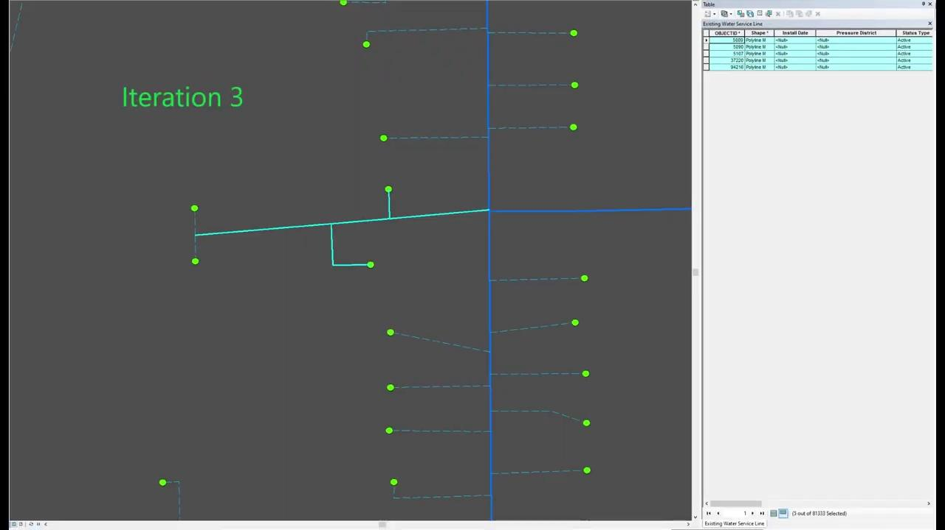
Party Line Predictor (Water Systems)
Pseudo Code: Part 1
Notice how the number of selected lines continues to increase with each iteration except the last iteration # 5. Due to the logic, the selection process runs until it notices no more lines are being selected. This is because there is no way to know apriori how many pieces of line are associated with one group.

Slide 6
Once the Dissolve tool has been used to dissolve all lines from the Service Lines layer based on the previously generate Group_ID
For every (now grouped and merged) service line in the Dissolved Service Lines Layer
SELECT the line
SELECT the entities (homes, businesses etc) that intersect this line
GET COUNT of the selected entities
If this count is > 1:
Update “Party Line” field to ‘YES’
Party Line Predictor (Water Systems)
Pseudo Code: Part 2

Slide 7
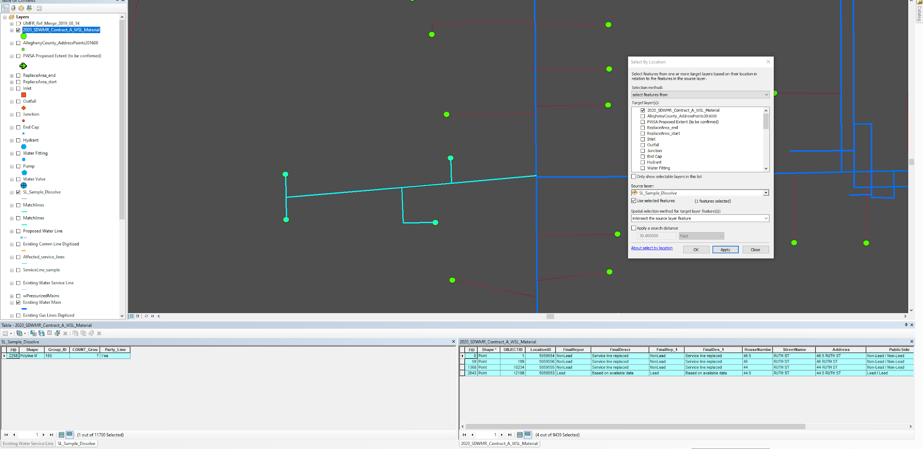
Party Line Predictor (Water Systems)
Pseudo Code: Part 2

Slide 8
Party Line Predictor (Water Systems)
Results
This process resulted in populating around 85,000 features from the Water Service Line data with a simple binary “Yes” or “No” value in the attribute table for whether a line is suspected of being a party line.
While the script still has potential for efficiency gains, its ability to complete this process in just over 10 hours is still exponentially less than the amount of time and effort that would be necessary to execute this process manually.

